Slide 1
The black PLAYER
PRESENTED BY:
HAMZA KHAN
MUHAMMAD FEROZ
AMMAR ADNAN
MUHAMMAD TAYYAB

Slide 2
OBJECTIVE
Appetite for digital content consumption is increasing day by day but gets limited.
We have devised a solution by producing this software.
We achieve desirable results by using compatible and very efficient data structuring and algorithms.
To learn Model View Programming Architecture

Slide 3
Benefits
This product has almost all functionalities required in today time.
You can play with all options you want
Its catchy theme makes it interactive for user.
It loads the mp3 files from system without interrupting the rest of work
Currently its for windows platform only.

Slide 4
user FUNCTIONALITY
File
Play/Pause
Next/Prev Button
Rewind
Volume Up/Down
Mute
Reset Play List
Shuffling
Full Screen
End

Slide 5
Tools we used
IDE:Qt Creator
Version: qt 5
Language: C++
QML((Qt Modeling Language) for Designing

Slide 6
Classes
QFileDialog
QMediaPlayer
Qtime
QAbstractItemModel
Algorithms
And GUI’s Classes
QMediaPlaylist
QFileInfo
Qdir
QPixmap
QListView( Comprises of Linked lists )

Slide 7
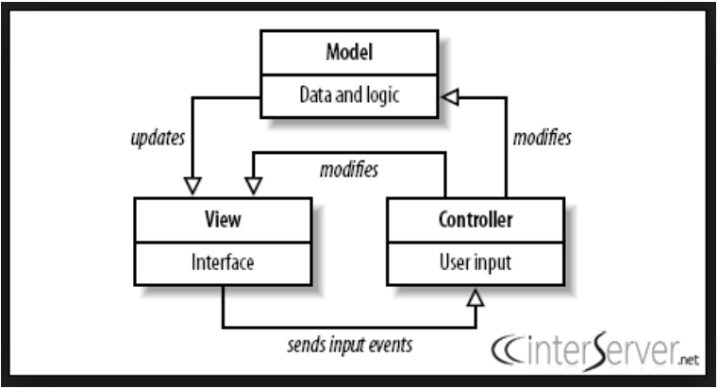
Model View Programming Architecture
Model
Interface(Controller)
View

Slide 8
:)PlalylistModel
QAbstractItemModel
PlaylistModel
https://doc.qt.io/qt-5.11/qtmultimedia-multimediawidgets-player-playlistmodel-cpp.html

Slide 9
Demo

Slide 10
Future Plans

